Slide 1
Linked List - Reorder List:
By: Chaya Goldstein

Slide 2
Prompt:
Reorder the list by alternating from front and back in-place.
Middle split, reverse second half, merge.
PROBLEM:
Given the head of a singly linked list L0 -> L1 -> … -> Ln, reorder it in-place to: L0 -> Ln -> L1 -> Ln-1 -> L2 -> Ln-2 ->…
Do not change node values; relink nodes.
Empty list or size 1-2: already “reordered”; leave as is.
The list is singly linked (no prev pointers)
You may not allocate a new list or array to store nodes.

Slide 3
Examples:
Example A:
Input: 1 -> 2 -> 3 -> 4 -> 5
Output: 1 -> 5 -> 2 -> 4 -> 3
Example B:
Input: 1 -> 2 -> 3 -> 4
Output: 1 -> 4 -> 2 -> 3
Edge:
Input: 1 ->
Output: 1 (unchanged)

Slide 4
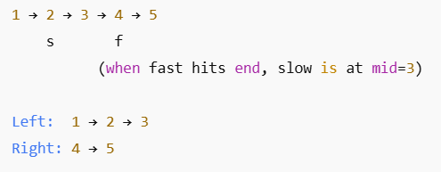

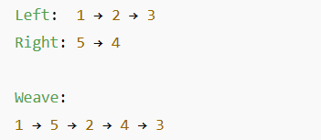
A: Middle Split With Fast/Slow:
3 STEPS:
B: Reverse the Right Half:
C: Merge one-by-one:

Slide 5
ALGORITHM:
Find the middle using slow/fast; for even length, slow ends at the last node of the left half.
Split: head1 = head, head2 = slow.next, then set slow.next = null.
Reverse head2 in-place.
Merge alternately: take one node from head1, then one form head2, until head2 is
exhausted (left may have one extra).
5. The head remains the same (start of woven list).

Slide 6
CORRECTNESS:
After step 1, slow is at the middle: left and right cover all nodes.
After step 2, head1 and reversed head2 partition the original list.
Merge loop invariant: before each iteration, the already-built prefix matches the pattern L1, Ln, L1, Ln-1… and head1 points to the next left node while head2 points to the next right node.
Each iteration appends at most one from each side, preserving the pattern;
Termination occurs when head2 finishes (right half never longer than left).

Slide 7
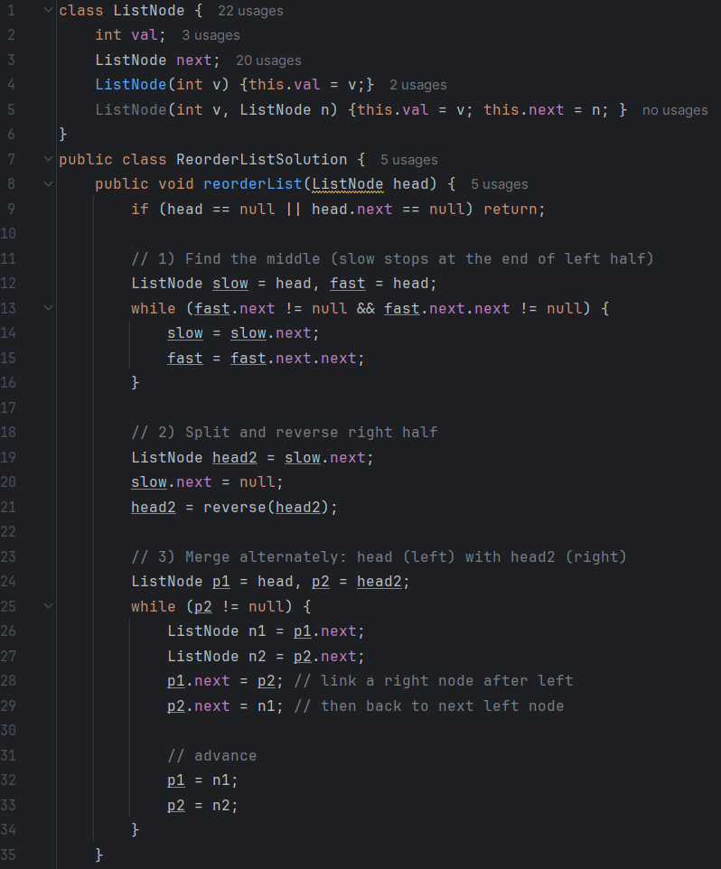
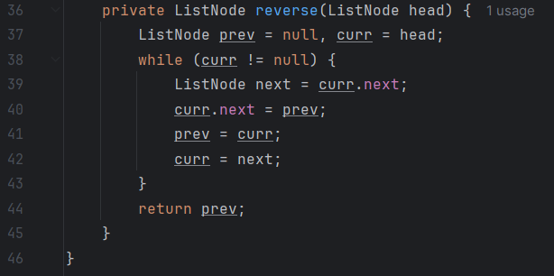

Slide 8
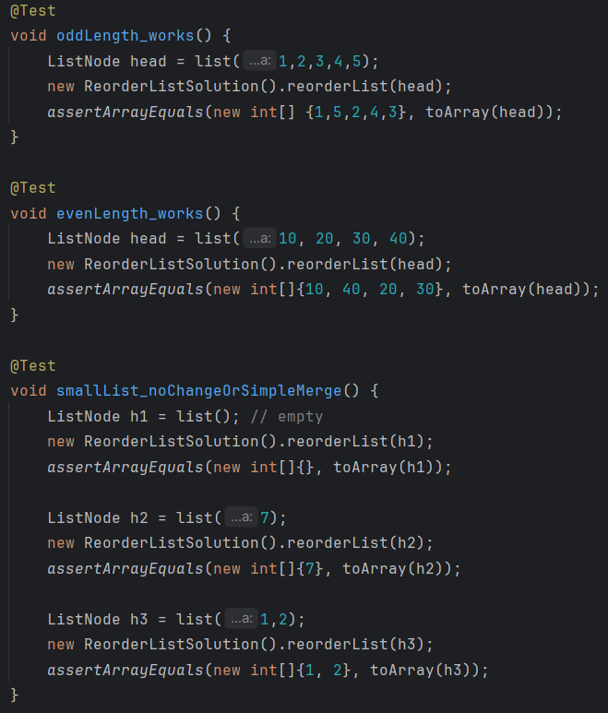

Slide 9
From the code:
From (1 -> 2 -> 3 -> 4 -> 5):
Find the middle: slow = 3, split into 1 -> 2 -> 3 and 4 -> 4.
Reverse right: 5 -> 4
Merge:
Start p1=1, p2=5.
Link 1 -> 5 then 5 -> 2 (the old p1.next), advance to p1=2, p2=4.
Link 2 -> 4, then 4 -> 3, advance to p1=3, p2=null.
Done: 1 -> 5 -> 2 -> 4 -> 3.

Slide 10
COMPLEXITY:
Time: O(n) – one pass to find the middle, one to reverse, one to merge.
Space: O(1) – only a handful of pointers

Slide 11
THANK YOU:)

